Slide 1

Master’s Challenge: Project Introduction
PUTTING Nutrient intelligence into the hands of the world’s farming community

Slide 2
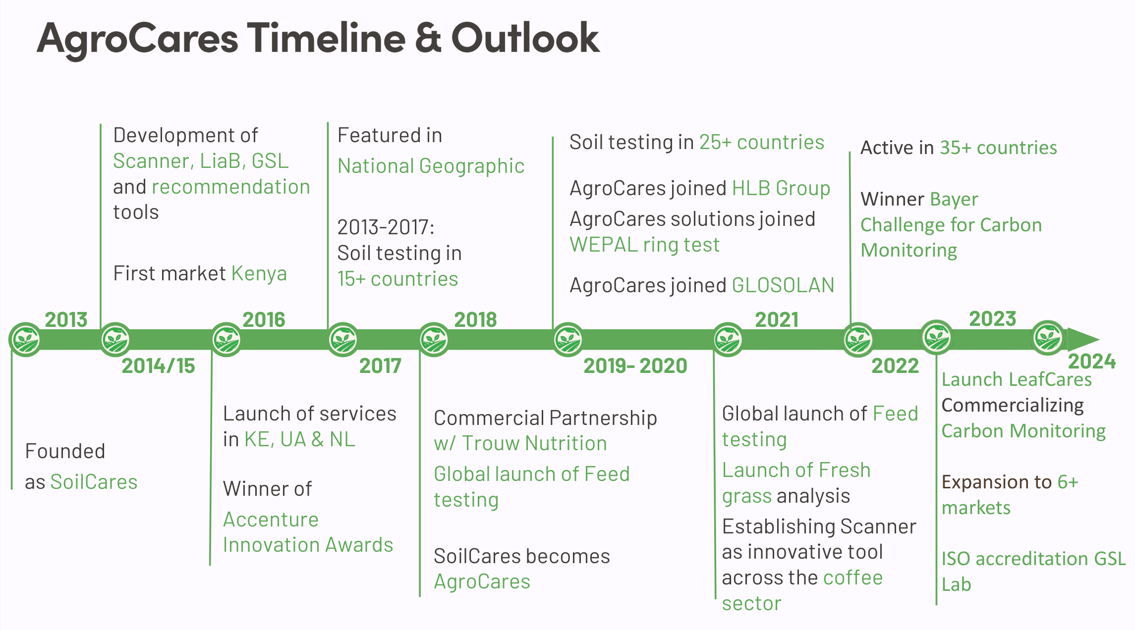
AgroCares Timeline
Shareholder Veris Investments joins
Featured in National Geographic
2013-2017: Soil testing in over 15 countries
Soil testing in over 25 countries
Global launch of Feed testing
Launch of LeafCares
Development of scanner, LiaB, GSL and recommendation tools
Test market Kenya
2013
2014 -2015
2016
2017
2018
2019
Founded
as SoilCares
Launch of services in Kenya, Ukraine & NL
Winner Accenture innovation awards
Shareholder Nimbus joins
Commercial Partnership with Trouw Nutrition
Services extended with Feed & Leaf
SoilCares becomes AgroCares
Loan Dutch Good Growth Fund

Slide 3



AgroCares services Practical, customisable applications, using the same tools in combination with different databases
Manage soil
fertility
On-the-spot insight
in your feedstuffs
Monitor crops
during growth

Slide 4
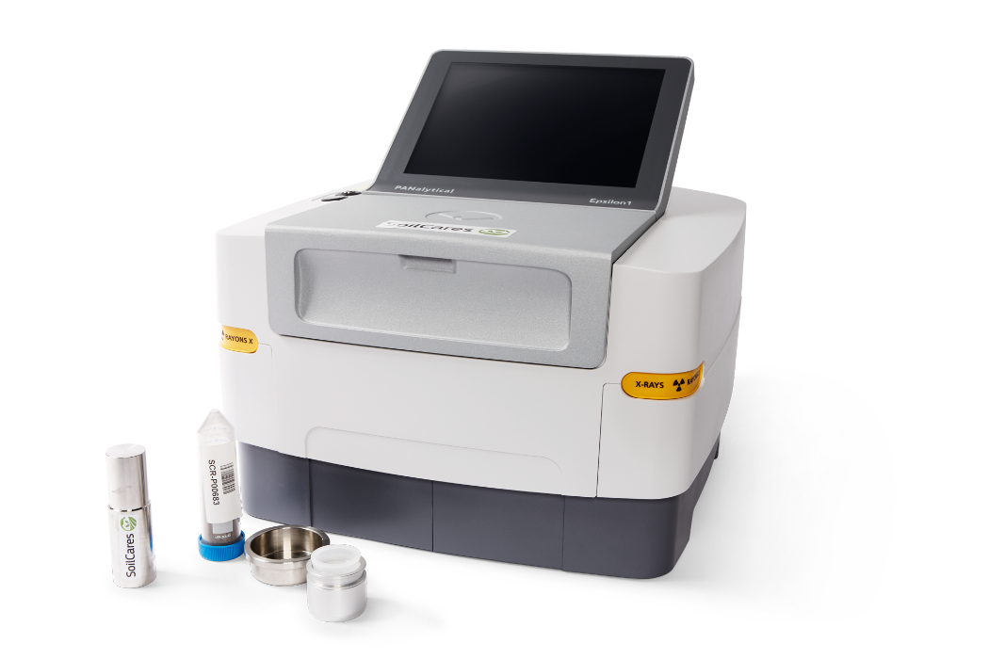
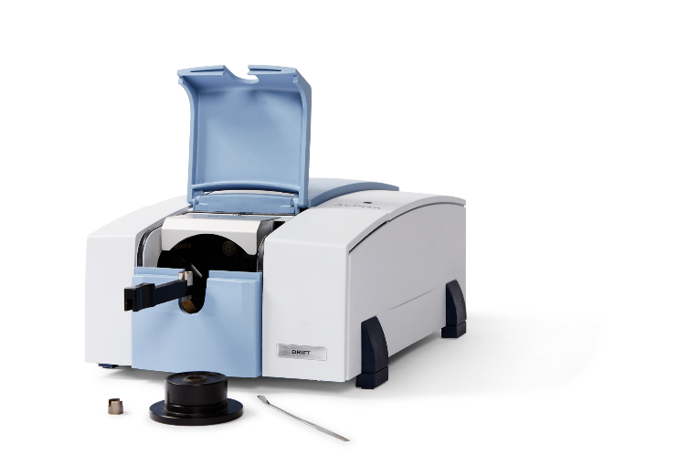
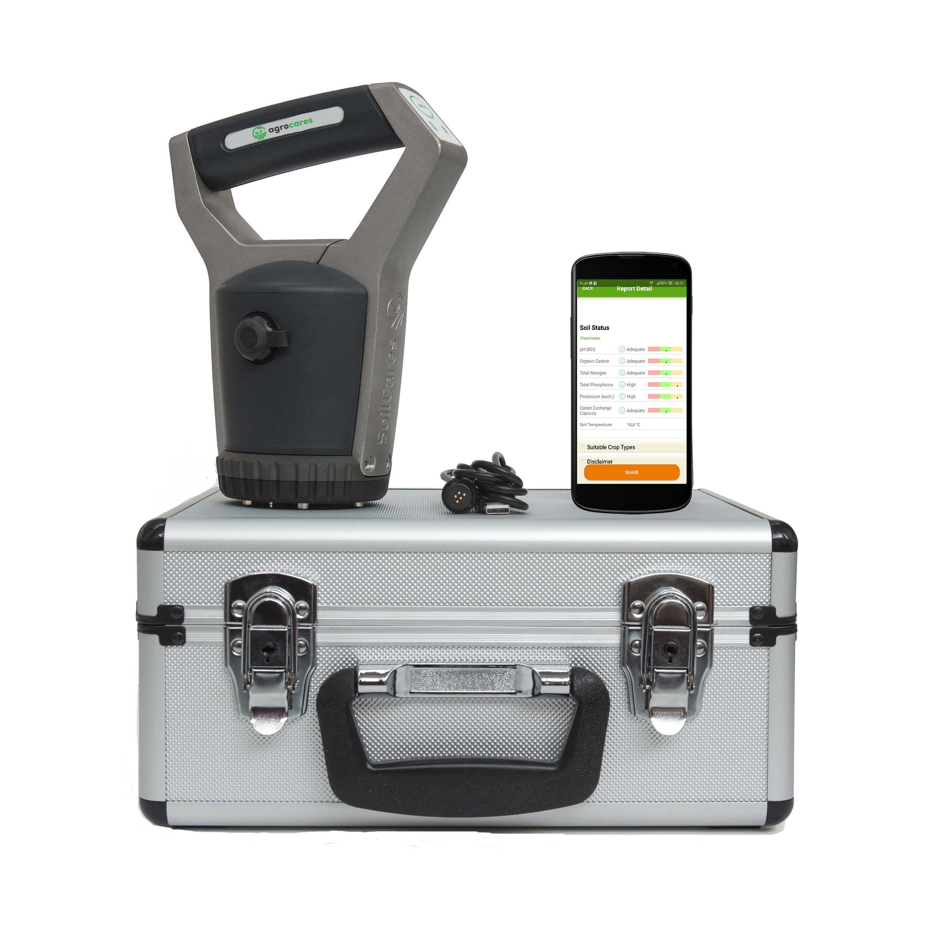
Scanner or LiaB: nutrients info for monitoring or detailed analysis?
AgroCares Scanner
with NIR sensor
Monitoring
AgroCares Lab-in-a-Box
with MIR spectrometer & XRF spectrometer
Data analysis

Slide 5
Prediction Models
All spectral data runs through our Deep Learning prediction models
Ensemble of CNN with covariates to predict multi-target outcomes
Covariates use location information to include globally available GIS data
Full details: https://doi.org/10.1016/j.geoderma.2024.116903
The quality of the models depends on the quality of our reference data (Project A)
Our global models perform at different levels – can we estimate the quality of a prediction? (Project B)
For both, an obfuscated dataset of our GSL wet-chemical reference dataset is provided
Sample IDs are unknown, but soil properties are known

Slide 6
Project A: Outlier detection in soil wet-chemical lab results
The quality of our models is only dependent on the quality of the reference data
Our ISO-accredited lab has many quality checks in place to ensure correctness, but mistakes are inevitable
This task involves:
- How can we effectively identify and categorise outlier samples within our lab reference dataset?
- What are the relationships identifiable between wet-chemical measurements and how can they be leveraged to predict likelihood of outlier?
- Can individual soil property measurements within samples be flagged as likely erroneous measurements?

Slide 7
Project B: Confidence Prediction of Near-Infrared Sensor Predictions
By comparing predictions against reference, we know when a sample is mispredicted
Can such a method be automated, based solely on prediction? Or soil type?
This task involves:
- Can the quality of a prediction be estimated accurately?
- Are there different types of soils that are predicted more or less accurately by our model than others?
- Will the developed confidence model hold on different prediction models for the same/different sensors?

